Slide 1

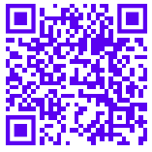

Descriptive Analytics
Bootcamp Women in Data
Angela Devia
Software development and Innovation Leader
https://cientificasdedatos.com/
Contact: http://www.angeladevia.com
Notes:
https://cientificasdedatos.com/

Slide 2

Content
What is Descriptive Analytics?
General description of the survey
Net Promoter Score and Self-Reports
Passive data collection
Media planning
Compilation and summary of causal data

Slide 3
What is Descriptive Analytics?
Aggregating past facts to understand situations, using scientific tools to:
Detect - Visualize - Describe - Identify - Calculate - Inquire
For decisions making related to KPI (key performance indicator), like:
ROI (Return On Investment), CLV (customer lifetime value), LCV (lifetime customer value), (LTV) lifetime value, CAC for Cost per Acquisition, etc.
In brief:
Market knowledge - Identify actions - Aid decisions making with data
Notes:
KPI (key performance indicator) https://www.eurtowergroup.com/business-indicators-kpi-roi-metrics-traction/?lang=en
https://www.marsja.se/explorative-data-analysis-with-pandas-scipy-and-seaborn/
What, how and how much are you spending to acquire and keep your clients satisfied?

Slide 4

GOALS
Why use Descriptive Analytics?
How use it?
What should we be focused on?

Slide 5
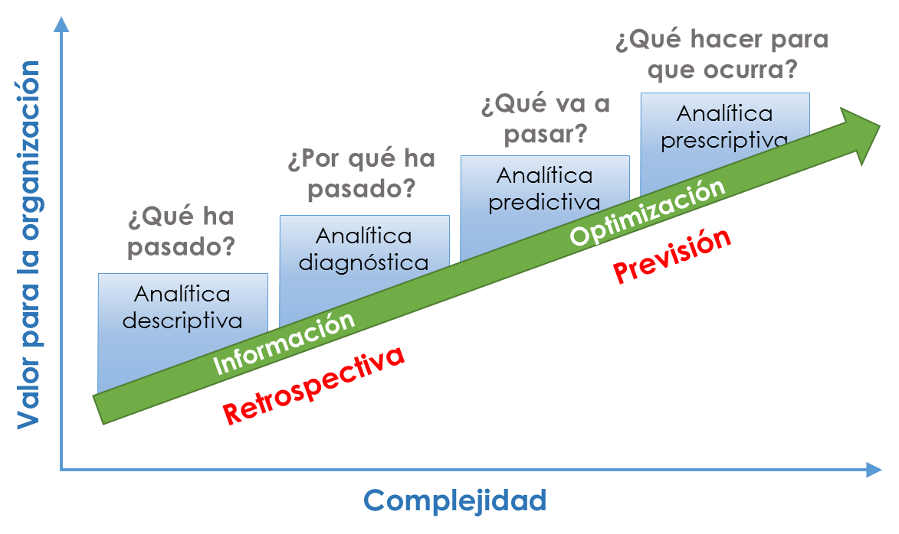
Notes:
https://www.lainnovacionnecesaria.com/el-nivel-de-madurez-de-las-organizaciones-en-el-analisis-de-datos/

Slide 6
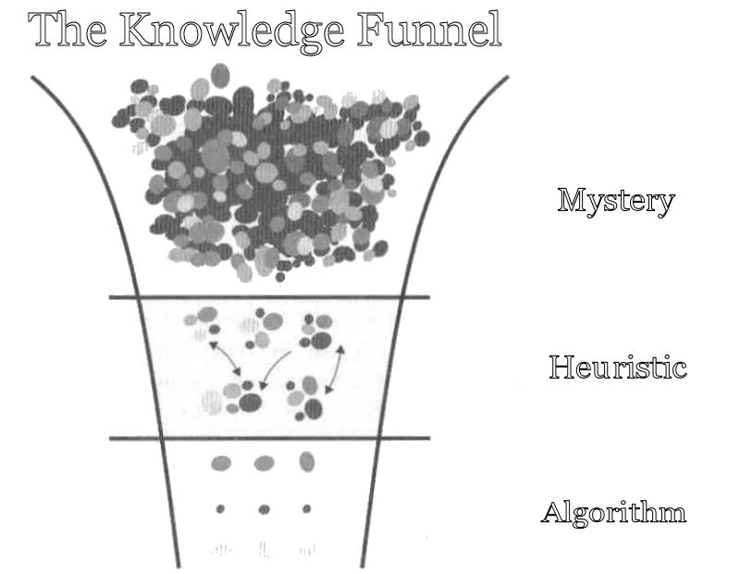
We don't know why things happen how they happen
We need to understand our current situation
Notes:
http://www.josebaldaia.com/intuinovare/tag/intuitive-thinking/?lang=en
https://tryolabs.com/blog/2017/03/16/pandas-seaborn-a-guide-to-handle-visualize-data-elegantly/
https://seaborn.pydata.org/tutorial/axis_grids.html

Slide 7
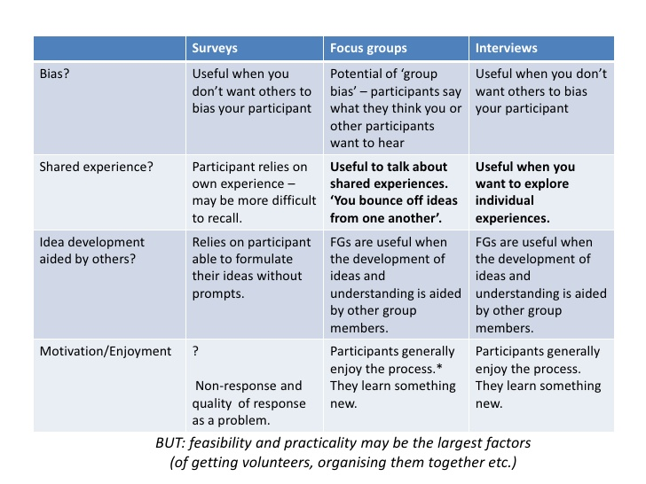
Acquiring data from customers:
Active & Passive techniques
Notes:
https://www.slideshare.net/tundeva/focus-groups-13246766

Slide 8
General description of the survey
It is an Active Data Collection, as same as self-reports (consumer behaviors)
Depends on the media, location and context
Media: Personal - Web - Mobile
Context: at the moment to keep it fresh
Type of questions
&
Validity + Reliability

Slide 9
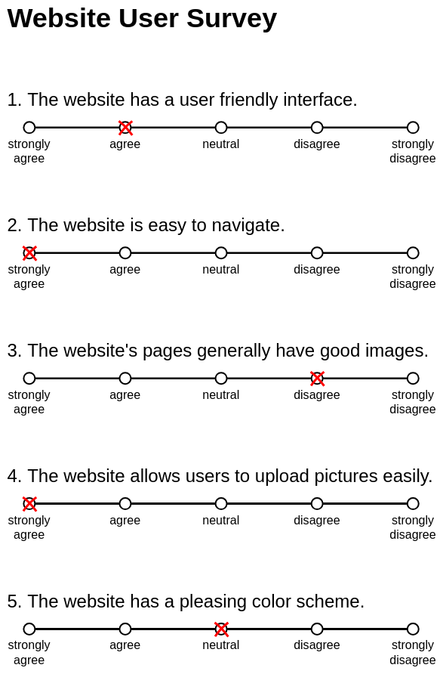
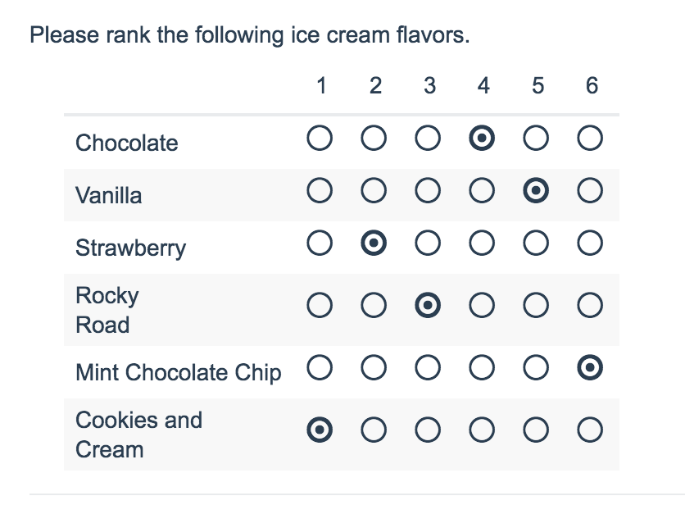
General description of the survey
Low cost
Easy
Learn about potential
Write it biased
Right audience
Tools

Slide 10
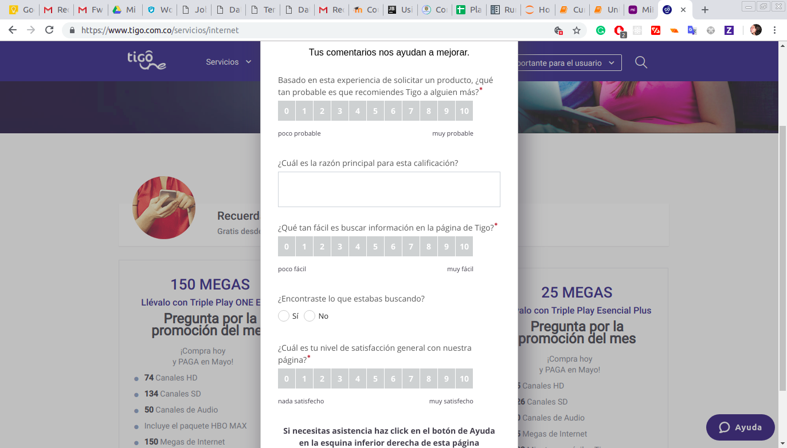
Net Promoter Score and Self-Reports

Slide 11

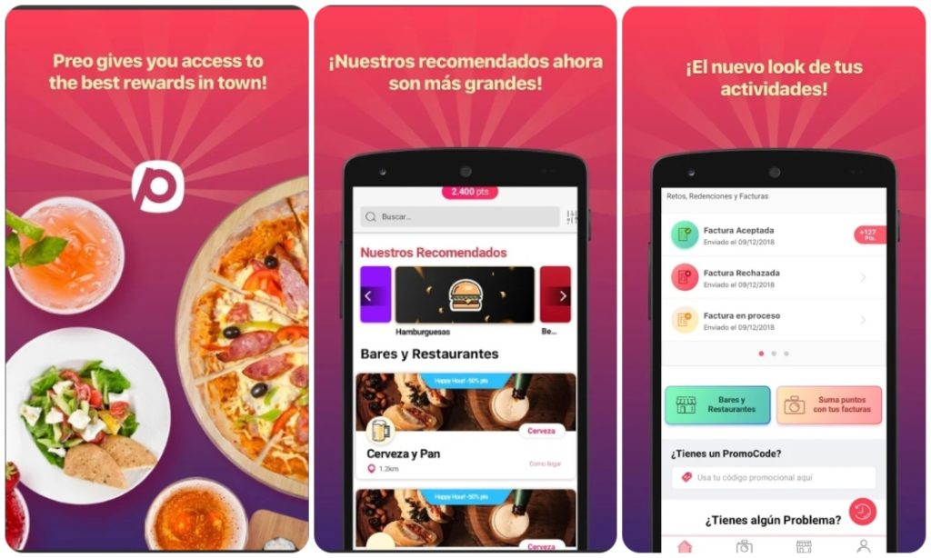

Net Promoter Score and Self-Reports
Net Promoter Score =
% de Promotores (de 9 a 10) - % de Detractores (de 0 a 6) *
Notes:
* de 7 a 8 son pasivos. Cómo capturar, como comparar y cómo ayuda a tomar decisiones
https://www.businesswire.com/news/home/20180711005274/en/InfoScout-Market-Track-Launch-Trade-Insights-Solution

Slide 12
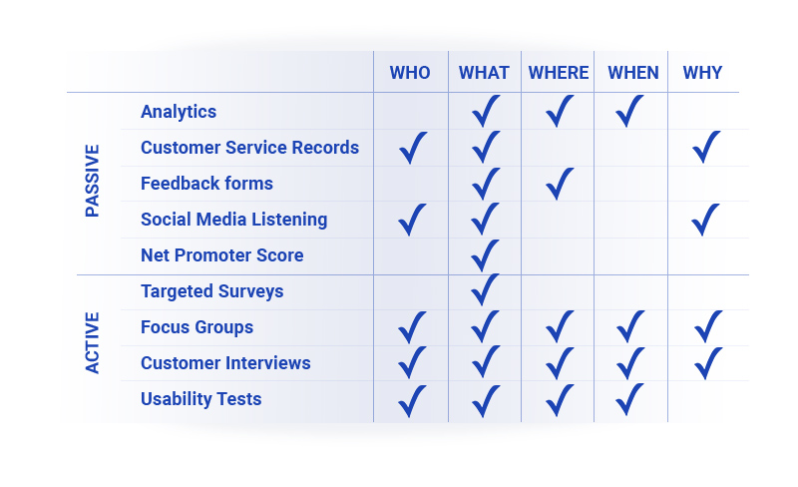
Passive data collection
Notes:
https://usertribe.com/blog/user-research-balance-meal-plan/
The Five W’s — Who, What, Where, When, Why — have been a useful tool for information gathering since we first learned about it in grade school. In terms of user research, the 5 W’s might answer questions like these:
WHO is this user? Which group or segment do they belong to? What is their background?
WHAT are they trying to do? What are their needs and their goals? What happened?
WHERE in the process do your users experience frustration? How do they move through the customer journey?
WHEN are they using your product? As they move through a process, when do they become frustrated?
WHY do they feel the way they do about your product? Why is a step in the process effective or frustrating? Why do they prioritize features differently than you or other customers? What makes them choose you over a competitor (or vice versa)?

Slide 13
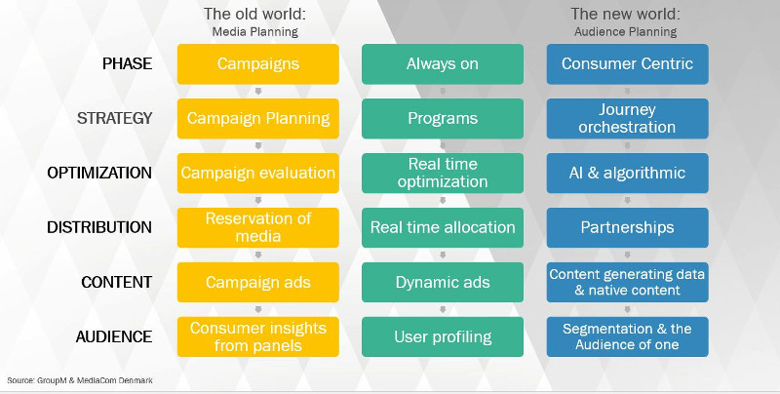
Media planning
Notes:
https://www.mediacom.com/en/think/blog/2017/say-goodbye-to-media-buying-and-hello-to-audience-buying

Slide 14
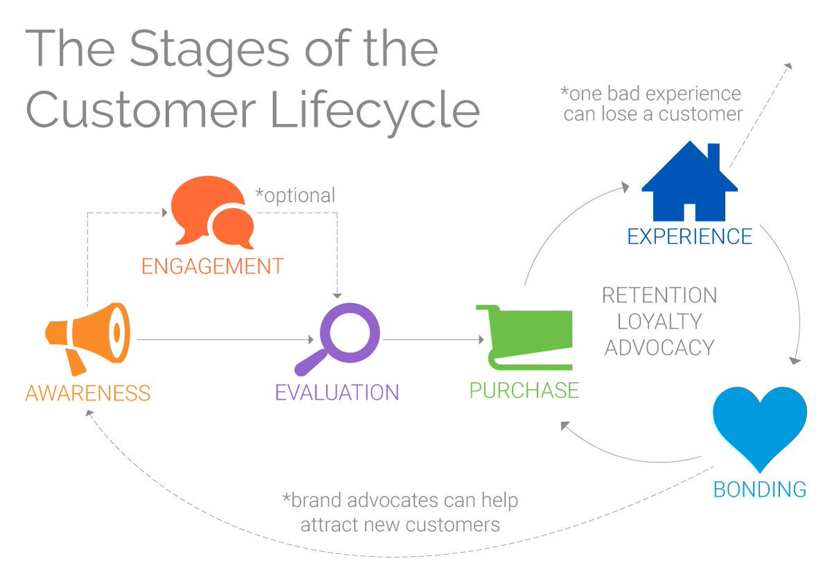

Slide 15
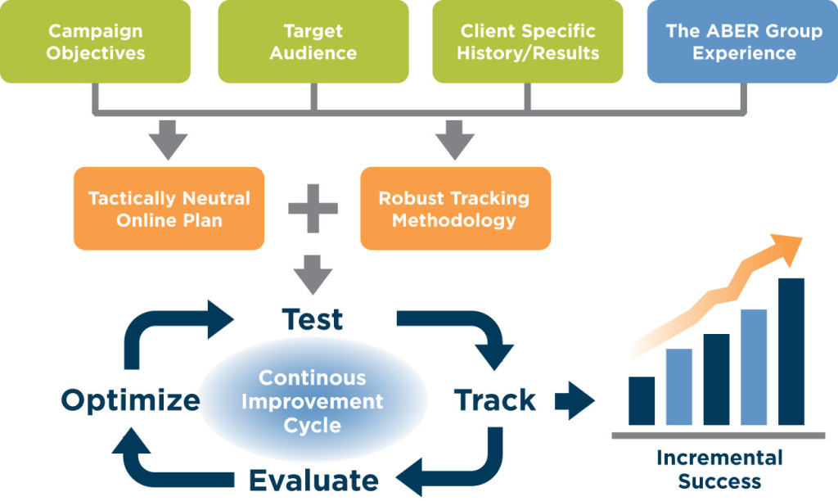
A company example
Notes:
https://www.abergroup.com/services/
Analítica avanzada - Calidad de las bases de datos - Gobierno de los datos

Slide 16
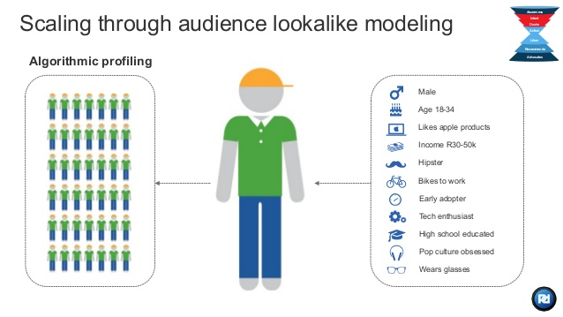
Goal: Profiling and look alike
Notes:
https://www.slideshare.net/dennisarmstrong/perform-dm-go-to-market-deck-may-2014-email
https://github.com/nikhitmago/lookalike-modelling

Slide 17
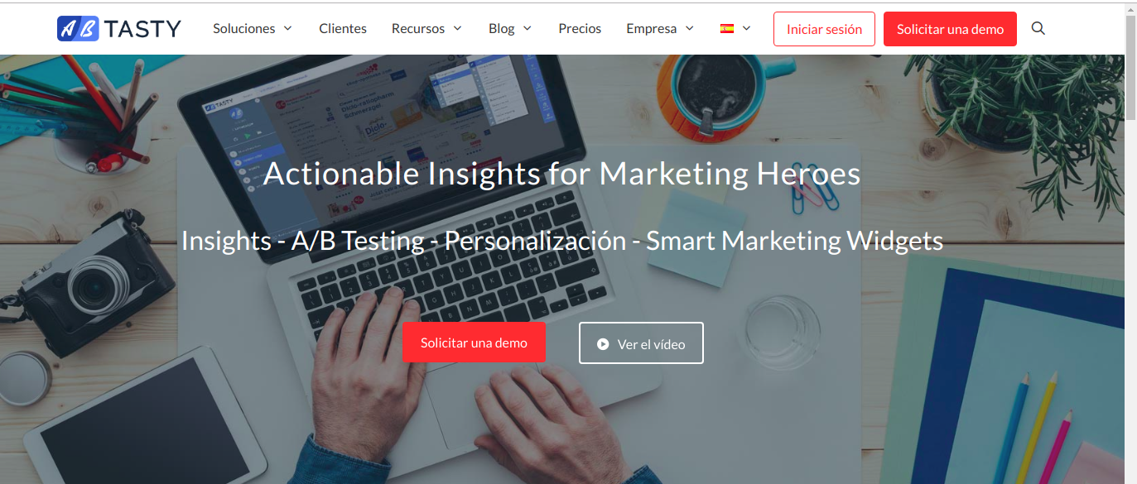
Compilation and summary of causal data
Correlation <> Causation
A & B -> C A -> B
AB TESTING* intentional changes in processes to be measured
Notes:
Causal inference guides: https://github.com/ijmbarr/notes-on-causal-inference
http://causalinferenceinpython.org/
AB Testing: https://www.abtasty.com/es/

Slide 18

RESUME
Why use Descriptive Analytics?
Handling knowledge about market behavior and business model
How use it?
Research→ Causal questions→Data collection→Tools
What should we be focused on?
Collecting & interpreting data

Slide 19

contacto@cientificasdedatos.com
Notes:
contacto@cientificasdedatos.com

